Slide 1
Pneumonia Detection

Slide 2
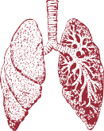


US
Pratyaksh Bhootra Anshika Nigam Yash Rai Sharma
Ra109
Ra106
Ra127

Slide 3
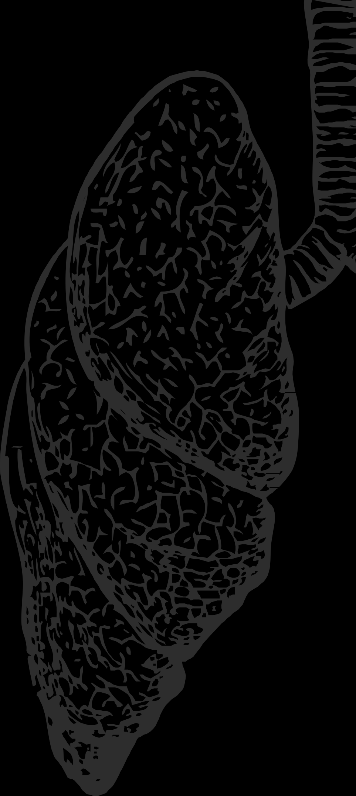
Problem Statement:
Pneumonia is a disease that spreads quickly and poses a serious risk to the health and well-being of its victims. An accurate biomedical diagnosis of pneumonia necessitates the use of various diagnostic tools and the evaluation of various clinical features, all of which are hindered by the lack of available experts and tools.
The main objective behind this project is to solve a complex process of detecting pneumonia and to provide a simple and faster approach in the field of medicine.

Slide 4
What Is Pneumonia?
Pneumonia is an infection that inflames air sacs in one or both lungs infection can be life-threatening to anyone.
The germs that cause pneumonia are contagious.
Both viral and bacterial pneumonia can spread to others through:
Inhalation of airborne droplets from a sneeze or cough.
By coming into contact with surfaces or objects that are contaminated with pneumonia-causing bacteria or viruses.

Slide 5
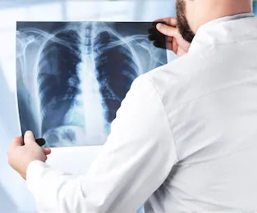
Symptoms
Coughing that may produce mucus.
Sweating or chills.
Shortness of breath.
Breathe or cough.
Feelings of tiredness or fatigue.
Loss of appetite.
Nausea or vomiting.
Headaches.

Slide 6
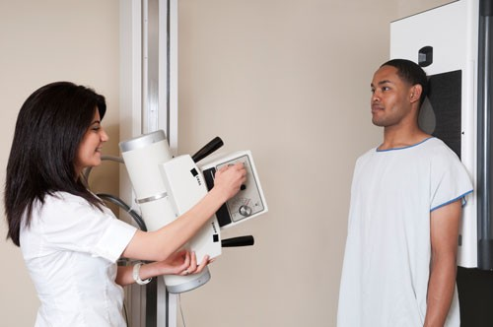
Physical Check-Ups
Chest X-ray.
Blood Culture.
Sputum Culture.
Pulse Oximetry.
CT scan.
Fluid sample.
Bronchoscopy.

Slide 7
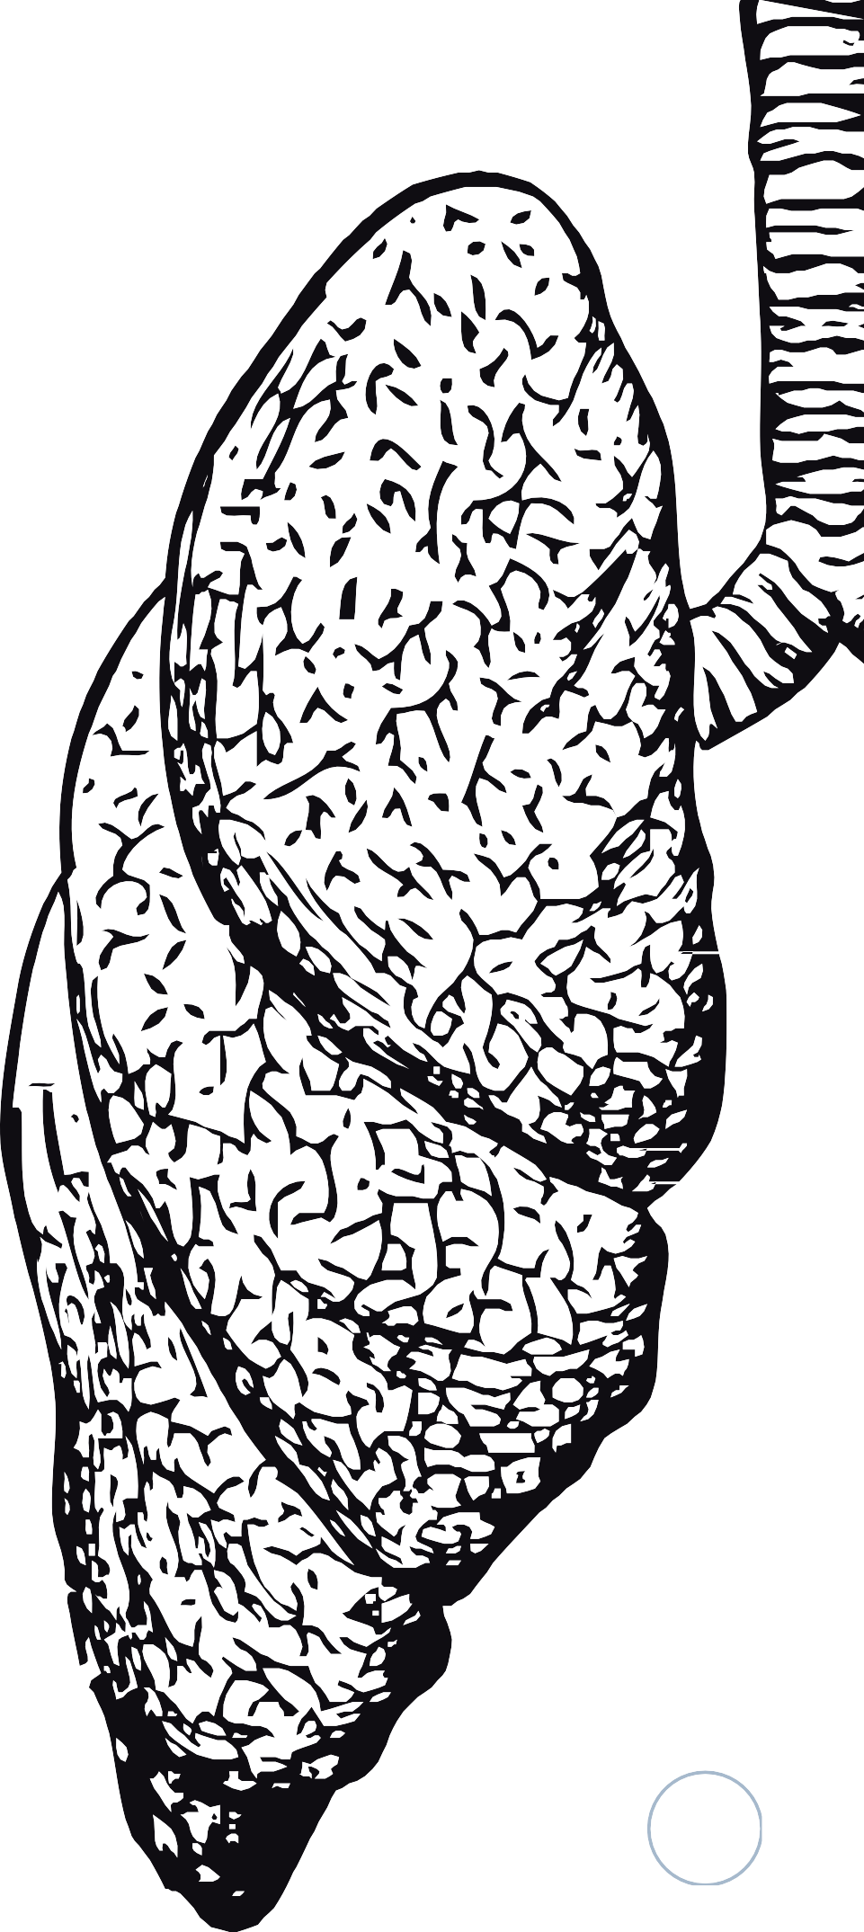
Pre-requisites
Good Knowledge of python programming language.
In depth knowledge over linear and logistic regression
Understanding of basic image processing.
Basic understanding on artificial neural networks and convolutional neural networks working and implementation.

Slide 8
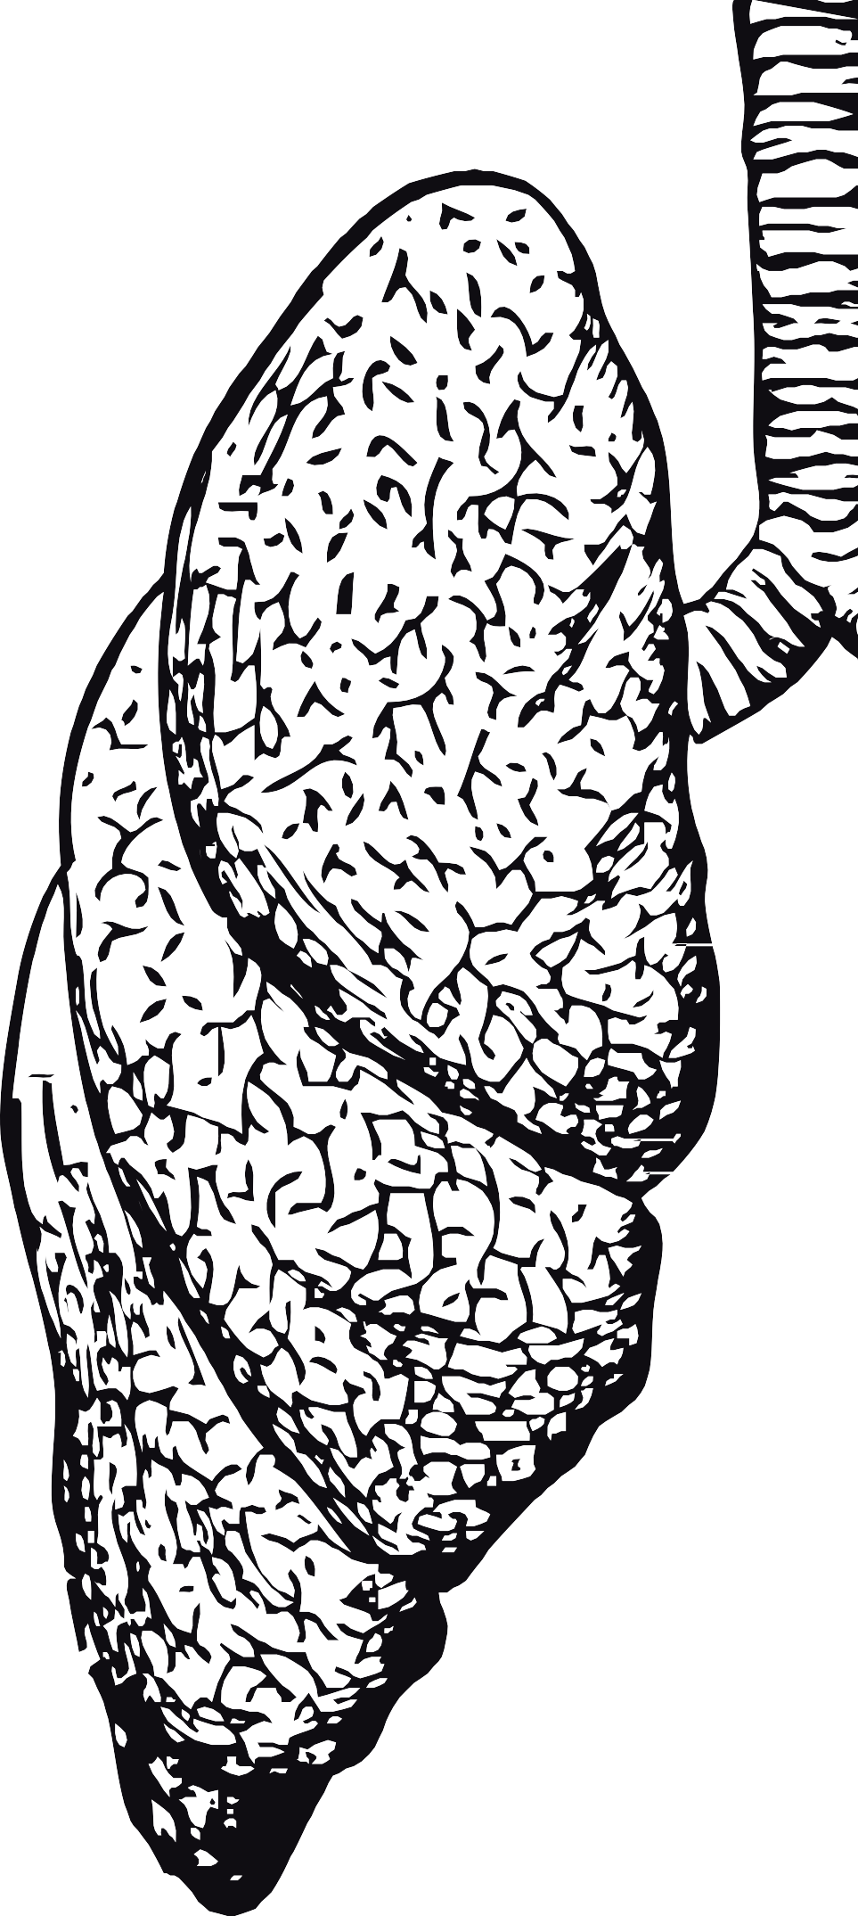
Classifying Chest X rays as Pneumonia or Normal
Dealing with Image data sets.
Performing Data Processing and Augmentation as and when required.
Creating and training a Convolutional Neural Network using Tensorflow 2.0

Slide 9


Chest X-Rays related to Pneumonia disease
An X-ray exam will allow a doctor to see lungs, heart and blood vessels etc to determine the presence of pneumonia.
Infiltrates that identify an infection.
Low contrast, overlapping organs and blurred boundary.
Medical value construct a
and application significance to stable and accurate automatic
detection model of pneumonia.

Slide 10
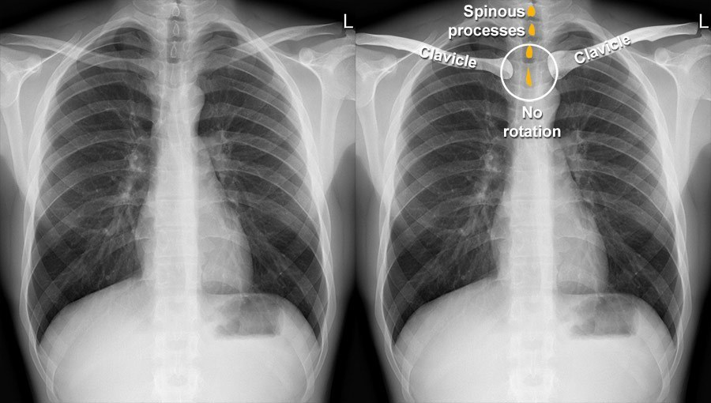
Chest X-Rays related to Pneumonia disease
Normal Lungs

Slide 11
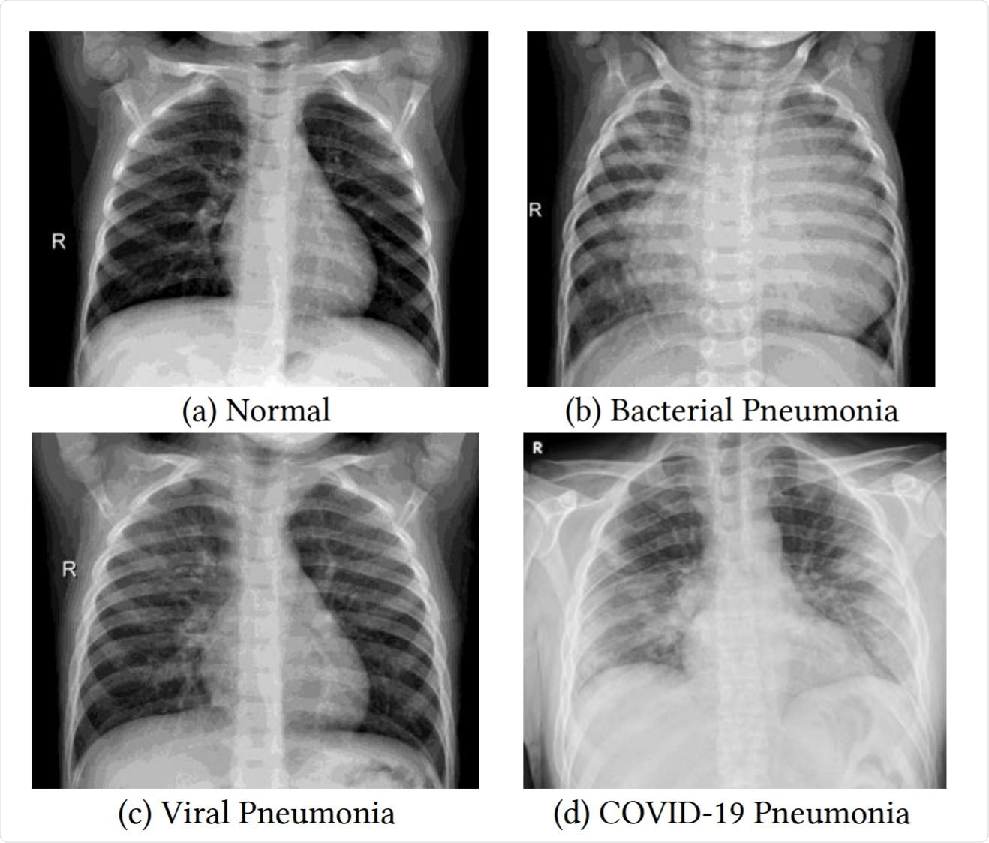
Chest X-Rays related to Pneumonia disease
Pnuemonia Lungs

Slide 12

Techniques
Tensorflow Dataset API
ResNets
Advanced Python Programming
Convolutional neural networks(CNN) using Tensorflow
Artificial Neural Network

Slide 13
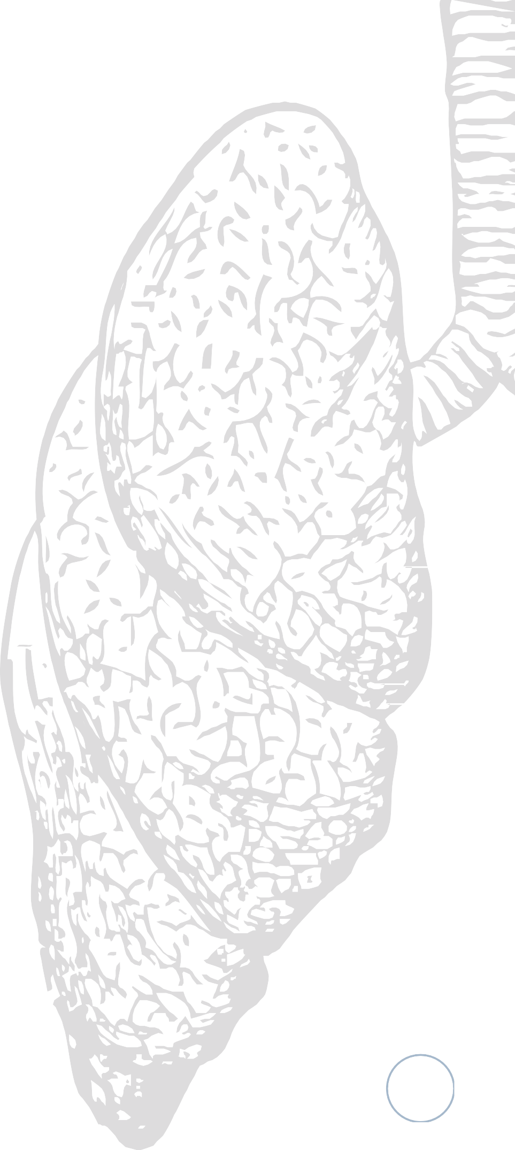
Tensorflow Dataset API
The TensorFlow dataset API helps us in writing custom and efficient input pipelines.
Dataset API is used for:
Creating a stacked object for Input data and labels.
Applying transformations to the data.
Iterating over the object to fetch the data.

Slide 14

ResNets
It was the time when ‘AlexNet’ was released and people were just trying to build bigger and bigger networks.
Bigger networks were actually getting better accuracies but there was a limit and after that the errors went higher i.e. no improvement in performance.

Slide 15
ResNet Background
“A deep network should perform at least equal to its shallow counterparts.
Consider a Network where Initial layers are the shallow network and remaining layers are Identity functions.”

Slide 16
Convolutional Neural Networks(CNN)
A convolutional neural network (CNN) is a subset of machine learning. It is one of the various types of artificial neural networks which are used for different applications and data types.
A CNN is a kind of network architecture for deep learning algorithms and is specifically used for image recognition and tasks that involve the processing of pixel data.

Slide 17
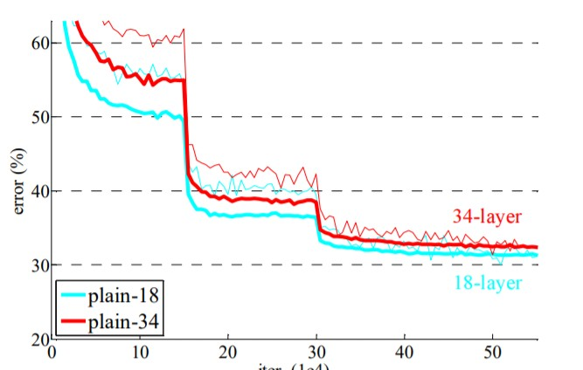
Issues using Plain Convolutional Networks
Validation errors for two plain convolutional networks
1. 18 layers.
2. 34 layers.
The error for a 34 layers network is higher compared to 18 layers.

Slide 18

Issues using Plain Convolutional Networks
Adding more layers can lead to more complex learning functions which might lead to an overfitting situation.
Deeper networks might face an issue backpropagating the gradients, this issue is most commonly called the ‘Vanishing Gradients’ problem.

Slide 19
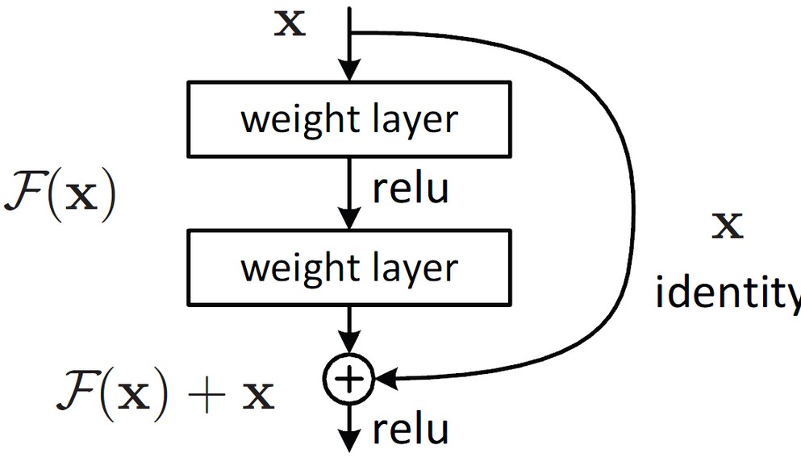
Residual Block
A residual block takes in the output of a layer and forwards the output to further layers.
It also remembers the past information which is nothing but the identity function.
This type of connection is also called “Skip connection”.

Slide 20
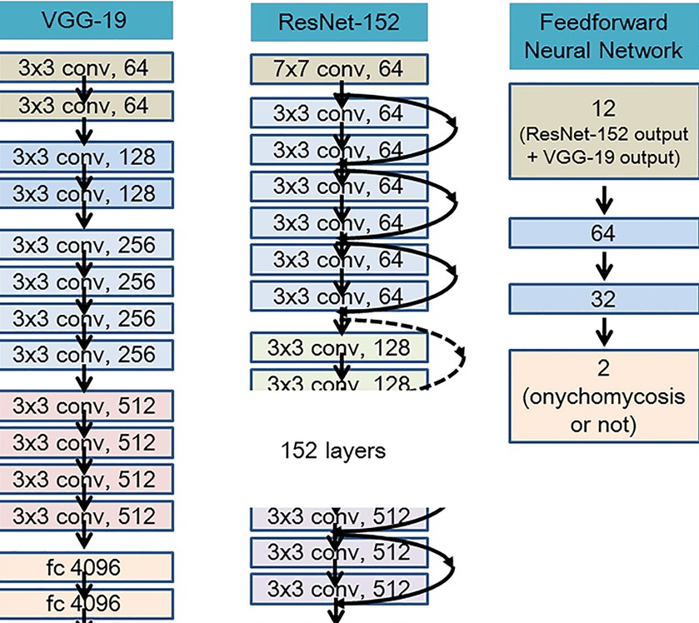
Deeper ResNet
They are very similar to each other except for the skip connections part.

Slide 21
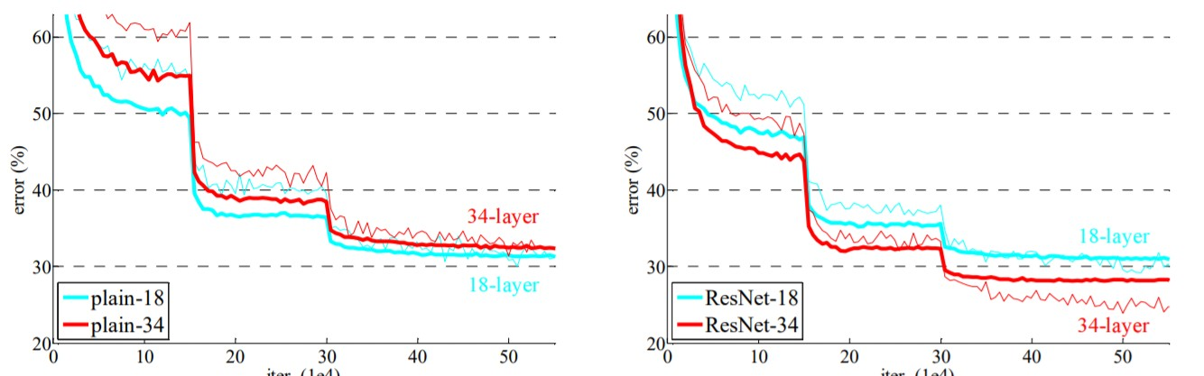
Plain Networks vs ResNets
There is not much difference in validation errors of plain 18 layers and ResNet 18.

Slide 22
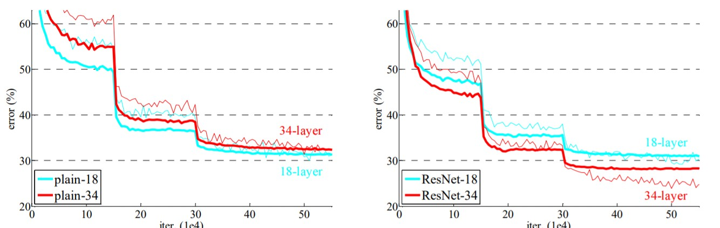
Plain Networks vs ResNets
Difference starts showing up when we use deeper models like resnet 34 and resnet 50.

Slide 23
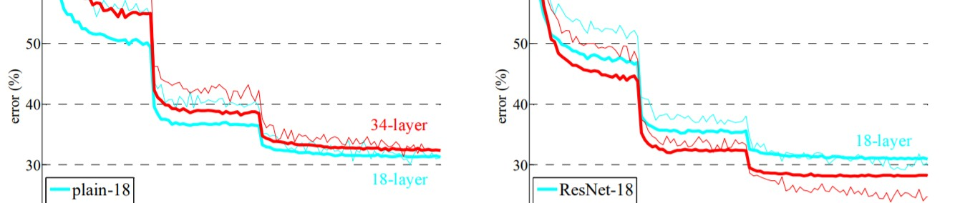
Plain Networks vs ResNets
Validation error for 34 layer resnet is significantly lower compared to its plain counterpart.
Difference will keep increasing with increase in the number of layers.

Slide 24
/ Experimental Results
To study the performance of each CNN classifier model, validation accuracy, recall was evaluated as the performance measures.
Accuracy and loss graphs were also studied.
The confusion matrix was also computed for each model.
The evaluation methods of the related work. To compare the proposed method with the related work, the key evaluation method will be employed for the evaluation of the proposed method.
This section will discuss the key evaluation methods, namely accuracy, precision, recall.

Slide 25
/Accuracy
Accuracy will justify the amount of predicted datapoints with respect to the rest of datapoints.
It is used to identify the performance of the model with respect to all classes.
Accuracy =number of correct predictions∕ total number of predictions.
Accuracy will help to determine the efficiency of the proposed model

Slide 26
/Precision
Precision will involve the number of positive predictions of the model, which means precision is enhanced when the amount of correct positive predictions is higher, and the total number of incorrect positive predictions are fewer.
Precision = true positive// (true positive + false positive) ,where true positive represents the correct prediction of positive class and false positive represents the correct prediction of negative class.

Slide 27
/Recall
Recall will compare the correct identification of positive sample with respect to all the available positive samples. It is involved in detecting the positive class and it is apart from the classification of negative samples. Recall is represented as:
Recall = true positive // (true positive + false negative),
where true positive represents the correct prediction of positive class and false negative represents the incorrect prediction of negative class.

Slide 28
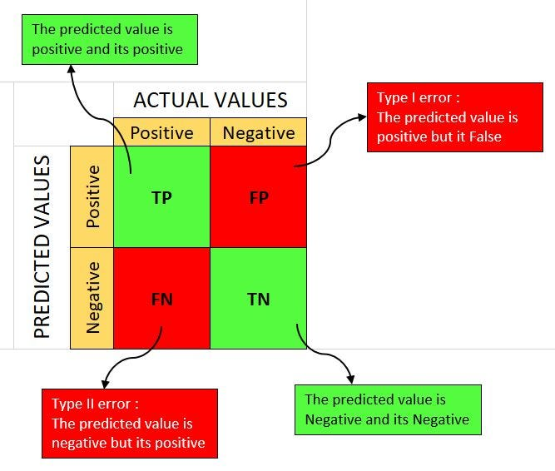
/ Confusion Matrix
The confusion matrix consists of four basic characteristics (numbers) that are used to define the measurement metrics of the classifier. These four numbers are:
1. TP (True Positive): TP represents the number of patients who have been properly classified to have malignant nodes, meaning they have the disease.
2. TN (True Negative): TN represents the number of correctly classified patients who are healthy.
3. FP (False Positive): FP represents the number of misclassified patients with the disease, but they are healthy. FP is also known as a Type I error.
4. FN (False Negative): FN represents the number of patients misclassified as healthy, but they are suffering from the disease. FN is also known as a Type II error

Slide 29
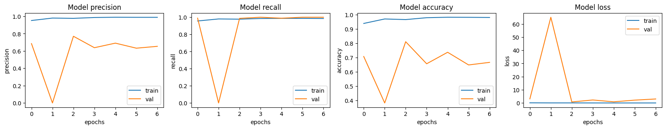
/Graph analysis of trained dataset

Slide 30
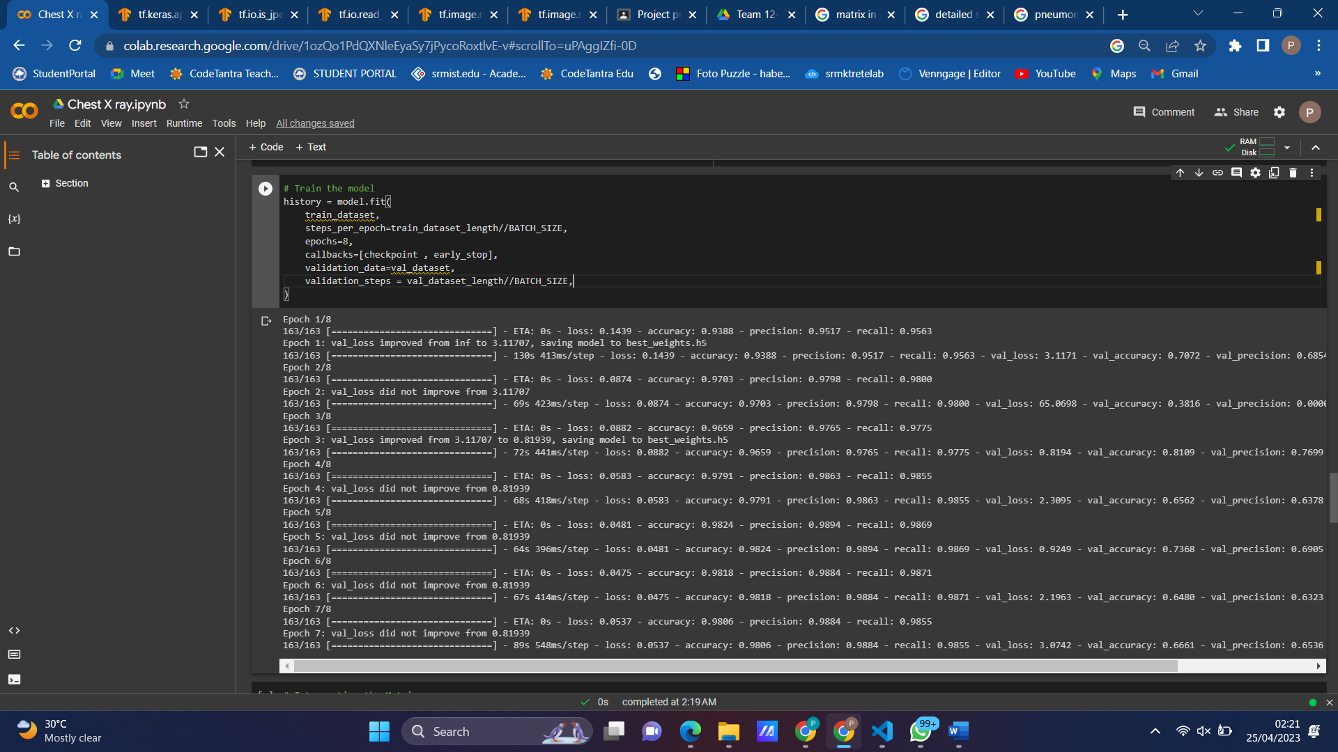
/Result Screenshot
Figure: Training Dataset

Slide 31
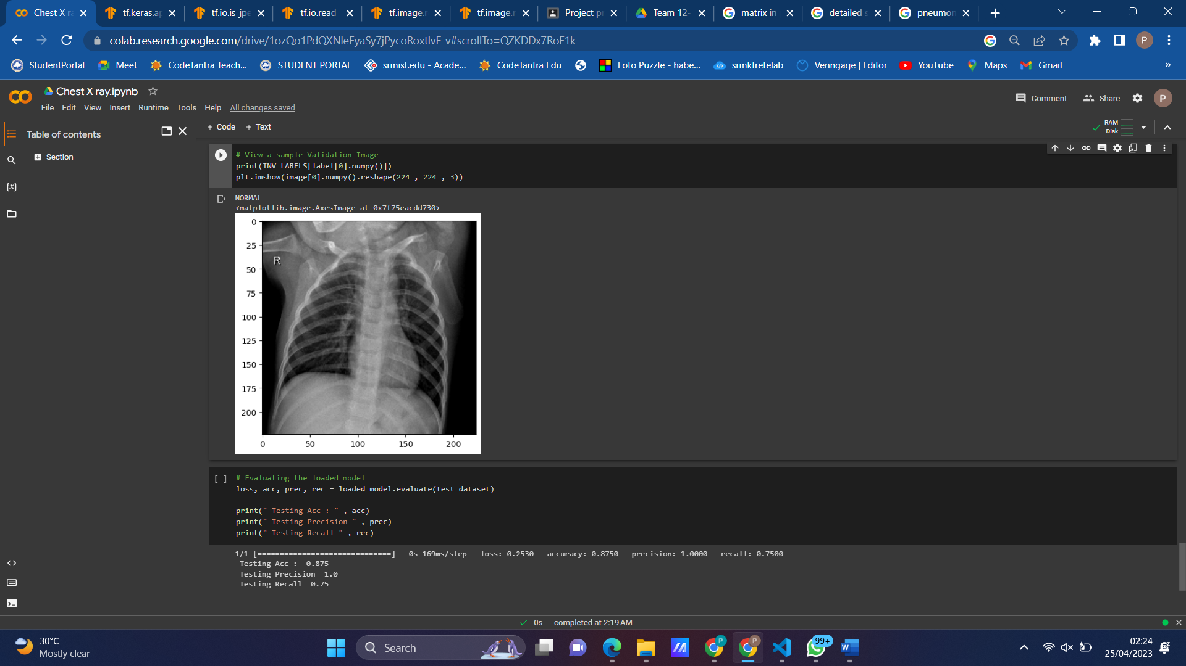
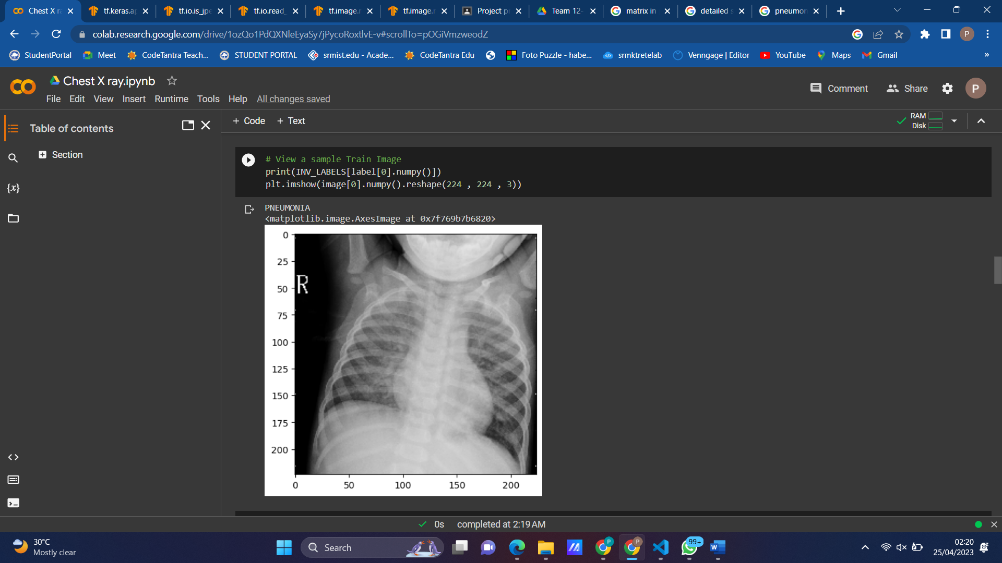
/Result Screenshot
Figure: Normal Lungs
Figure: Pneumonia Lungs

Slide 32
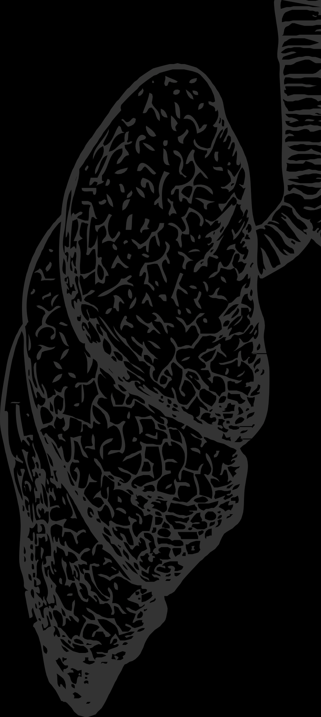
Key Takeaways
We need to apply some rresampling ttechniques to make it balanced.
We need to apply some data transformation techniques.
We must perform univariate and bivariate analysis to understand the better.

Slide 33
More Things to Try
Medical problem statements are complex and there's a high chance to miss some important point before solving the issue.
X-ray scanners made by different companies do post processing in different ways.
Changes are huge in pixel level.
To improve the existing dataset by collecting X rays from multiple hospitals and different machines.

Slide 34
More Things to Try
Augmentation
Augmentation is the tricky part in medical imaging. We cannot use most of the augmentations
It might change the image itself.
To use augmentations which do not affect pixel values like horizontal rotations , random image cropping.
We could also try out blurring images in a minimal way.

Slide 35

Summary
Google Colab and GPUs.
Datasets consist of Images, Text, and Videos. to Set up the environment for solving deep learning problems.
How to use TensorFlow to build Convolutional Neural Networks.
Identify and detect pneumonia from the Chest X Rays using the ResNet architecture.
Real time Response using APIs.

Slide 36
THANK YOU !!

